Slide 1
Strengthening Land and Revenue Governance through a Technical Support Unit (TSU)
Submitted to: Revenue Department, Government of Rajasthan
September 2026
Private and confidential

Slide 2
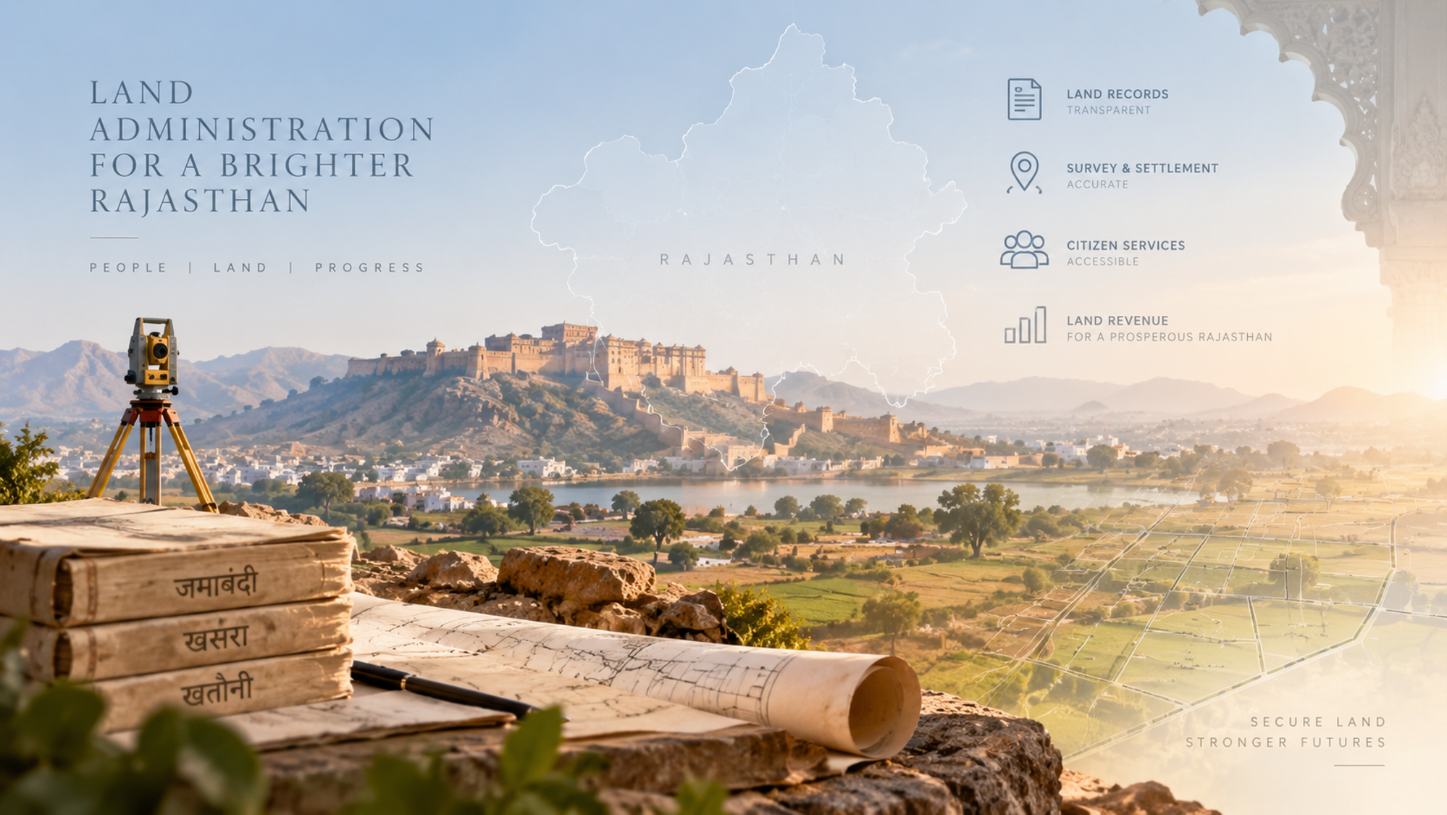


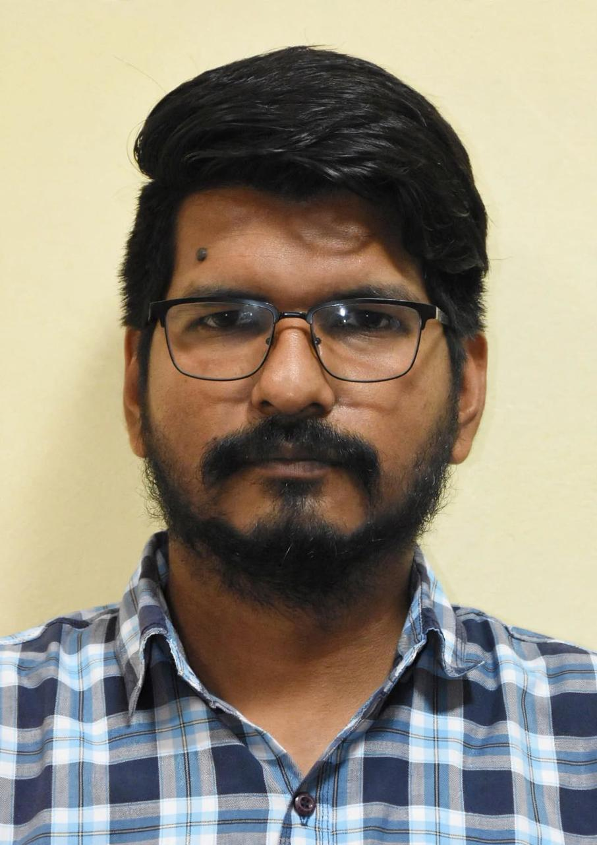


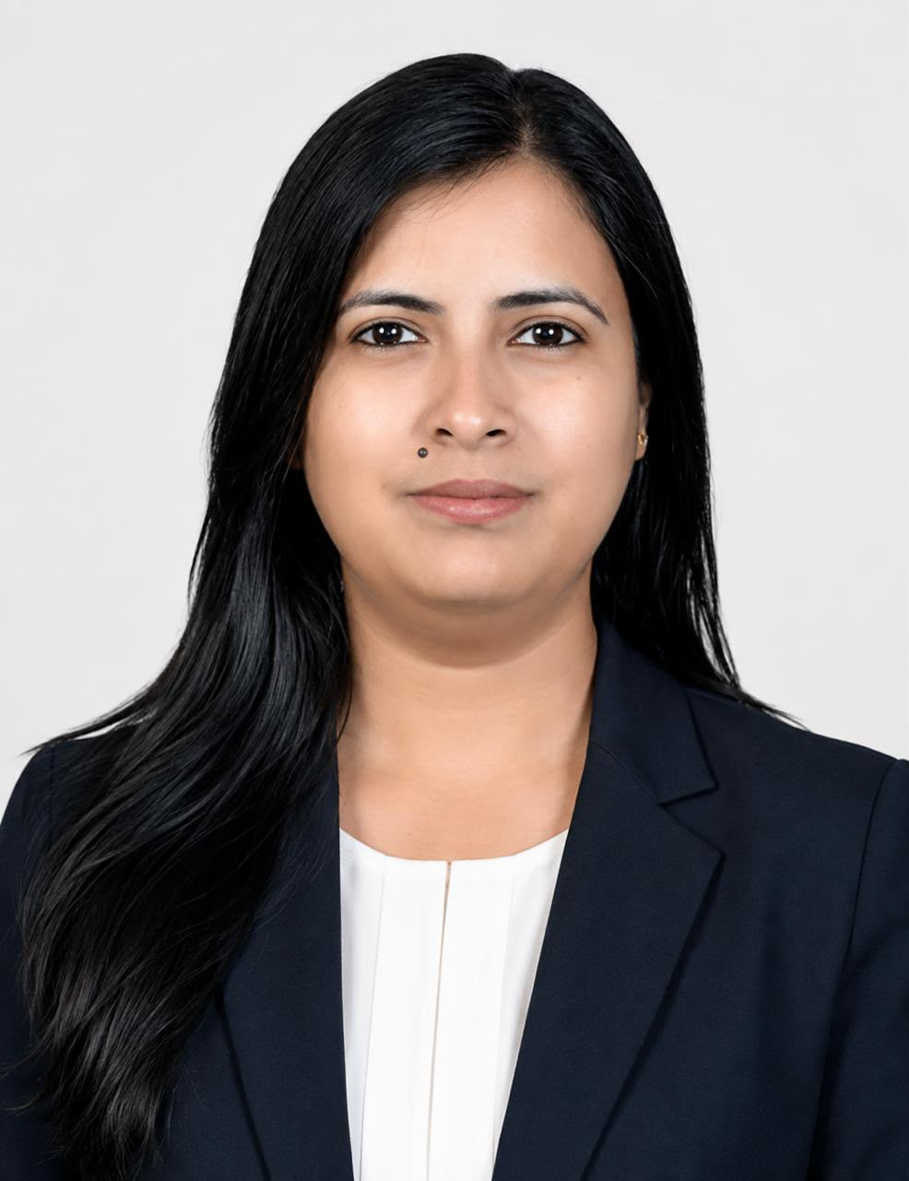
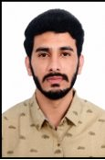
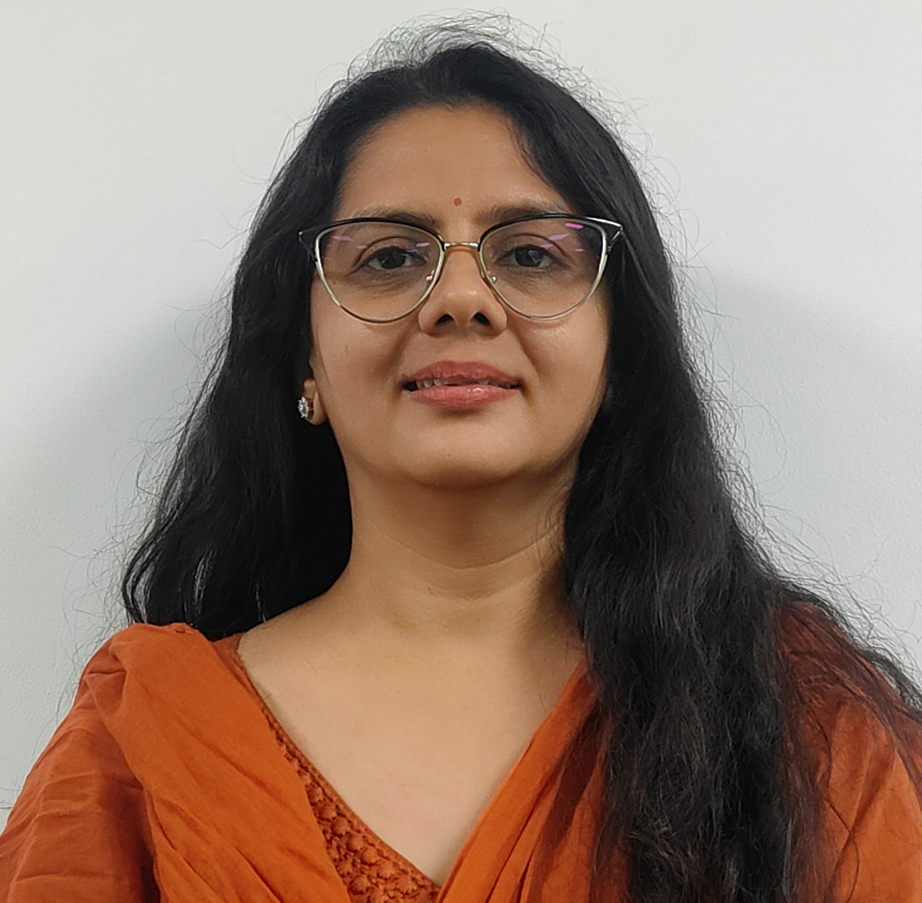
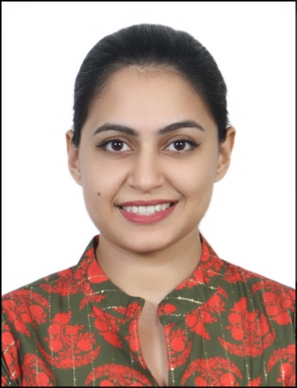
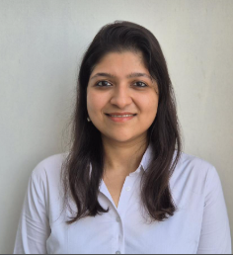
With you today
Pawan Tosniwal
Partner
Engagement Partner Deloitte
Ashwin Tiwari
Director
Team Leader
Rahul Galtwani*
Policy Expert
Parul Tiwari
Sr. Consultant
Business Process Expert
Prerna Singh
Consultant
Research Analyst Expert
Payal Sharma*
Data Analytics
Expert - 1
Ajay Singh Nathawat*
Data Analytics
Expert - 1
Apeksha Sharma
Associate Director
Additional Support to the Team
Chetna Rathore
Senior Consultant
Additional Support to the Team
Shreya Dalmia
Associate Director
Additional Support to the Team
Note* - The * candidates will join the firm soon

Slide 3
Table of Content
01
Introduction
02
Deloitte’s Point of View
03
Delivery framework, methodology & workplan
04
Team Overview
05
Our Experience

Slide 4

1. Introduction

Slide 5



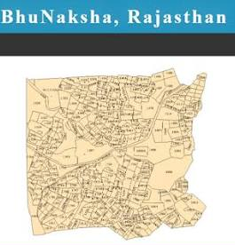

Introduction
Rajasthan has an extensive land administration ecosystem, with significant digital and institutional foundations
51,000+ |  | 8+ |  | 15+ |  | ₹ 1,700+ Cr.
Villages across 41 districts for land governance |  | Services provided to 8+ crore citizens in the State |  | Acts administered along with relevant rules, policies etc. |  | Land revenue collected in 2025-26 (RE)
Institutional Structure
Revenue Department
Nodal responsible for land administration, land records, revenue collection, settlement and land management across Rajasthan
Digital Ecosystem
Mandate & Functions
Apna Khata: Online land-record platform providing citizens access to Jamabandi/ RoR and land-related services
Land administration: Land records, survey & settlement, maps, govt. land etc.
Departments/Agencies
Board of Revenue for Rajasthan, Ajmer: Apex authority for revenue adjudication and administrative oversight
Settlement Department: Conducts land surveys, settlement operations and record updates
Colonization Department: Administers land allotment and rehabilitation initiative
Revenue Research & Training Institute (RRTI), Ajmer: Builds capacity through training, research and revenue reforms
Service delivery: Mutation, partition, conversion, boundary demarcation etc.
BhuNaksha: Digital cadastral mapping platform providing parcel-level maps and spatial land information
Revenue collection: Lease revenue, land allotment, conversion premium etc.
Rajasthan has established significant digital and institutional foundations for its vast land administration - the opportunity now is to integrate these foundations, improve process efficiency and unlock the economic and revenue potential of land.
Field Offices
Divisional Commissioner » District Collector » Sub-Divisional Officer / Assistant Collector » Tehsildar / Naib Tehsildar » Inspector Land Records / Patwari

Slide 6
2. Deloitte’s Point of View

Slide 7
Five Strategic Priorities for Trusted Land Governance
Aligned with Viksit Bharat & Viksit Rajasthan 2047 vision - Unlocking the economic potential of land
Integrated Land Governance Ecosystem
1
2
3
Parcel Centric Land Administration System
Improve Service Delivery for Citizens and Businesses
Land Intelligence for Planning & Governance
One Parcel – One Single Source of Truth
One Land Gateway
Digitization of Land Records to Land Intelligence
Move towards one Unique ID, Transaction History, Spatial Representation, Litigation Status & Fiscal Profile
Search, Access, Apply & Track land transactions/Information through one Gateway. Reduce time-to-title for citizens and time-to-plot for investors.
Insights on land assets, encroachments, litigation, conversion, valuation & land revenue feeds into Govt’s Planning
4
5
Enhance Revenue to Widen Fiscal Space
Coherent Legal & Regulatory Framework
Traditional Land Revenue to Greater Fiscal Value
Legal Certainty to Reduce Land Disputes
Enhance accuracy, coverage & compliance of the land revenue base to support State’s overall fiscals
Codification into a Unified Land Code would eliminate legal ambiguity, jurisdictional overlaps & reduce land disputes.

Slide 8
Deloitte’s Point of View: Integrated Land Governance System
Integrated Land Governance Ecosystem
Key Challenges
Deloitte’s Point of View
Parcel Master Registry - Every eligible parcel should have a unique identity and a common digital profile across – RoR - spatial data, fiscal, litigation, transaction events, encumbrance, history, etc.
Multiple departments → multiple systems → multiple records for same land parcel → manual reconciliation → delayed decisions
1
Digital integration (across multiple systems) and intelligence architecture for land administration
2
Spatial – Textual mismatch
Operate as an interoperability layer. Existing applications stay while their services become connected.
Delay in updating land records after land sale, inheritance or partition
3
Automated Rules & Workflow Engine - Officers should spend their time on exceptions, grievances, appeals and adjudication—not on repetitive data entry, manual reconciliation, and record copying.
Unified portal for land services for Citizens & Businesses

Slide 9
Deloitte’s Point of View: Integrated Land Governance System
Improve Service Delivery for Citizens & Businesses
Key Challenges
Deloitte’s Point of View
Manual citizen service processes result in operational inefficiencies, delays, and reduced transparency
1
Design & Implement One Land Services Gateway for Citizens/Businesses for improved experience
Lengthy forms, difficult to understand by citizens – need for intermediaries
2
Identify Parcel → View Eligible Information → Apply → Pay → Track → Receive certificate/order → Appeal & Grievances
Need for multiple visits to the field offices for single application
3
Pre-filled information from system records
Inadequate timely response for grievance redressal
4

Slide 10
Deloitte’s Point of View: Integrated Land Governance System
Land Intelligence for Planning & Governance
Key Challenges
Deloitte’s Point of View
Design & Implement Land Intelligence Solution – move from digitizing land data to decisions for Government’s socio-economic-fiscal planning & execution.
Land related data/information is spread across multiple systems/departments/courts
1
Land records contain discrepancies, legacy entries and non-standardized data structures
Key aspects would include:
2
Land Asset Intelligence – Identify, protect and assess legitimate future use, flag for land utilization review, prioritize recovery for encroached land, etc.
Litigation status/Stay order may not be visible downstream
3
Land Revenue Intelligence – Demand, collection, arrears and recovery performance, transaction analytics & valuation anomalies, fraud detection, etc.
Land Litigation Intelligence - Identify parcels/issues with recurring litigation, case ageing + value involved + parcel-risk dashboards, etc.

Slide 11
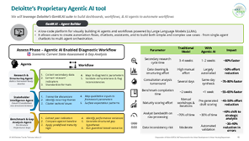
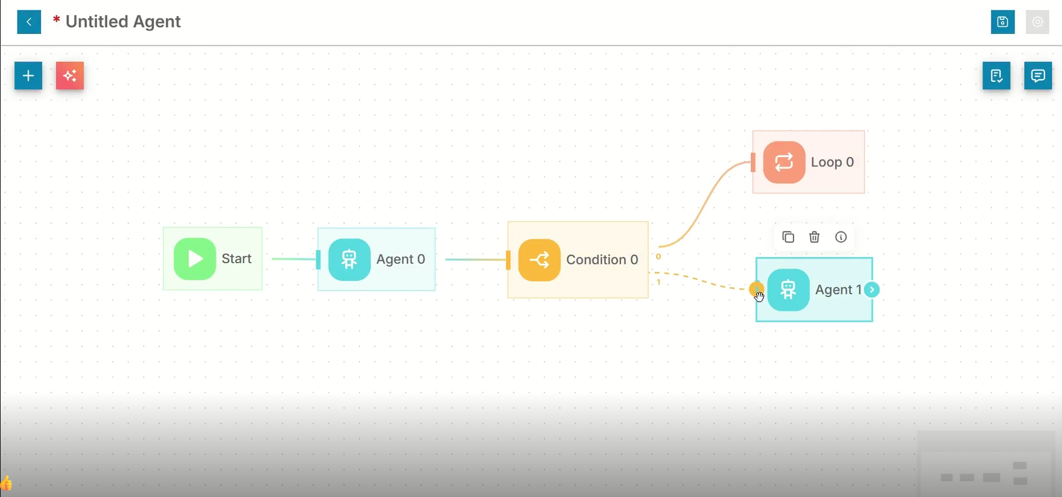
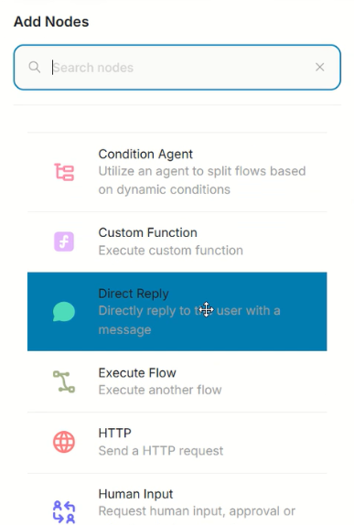
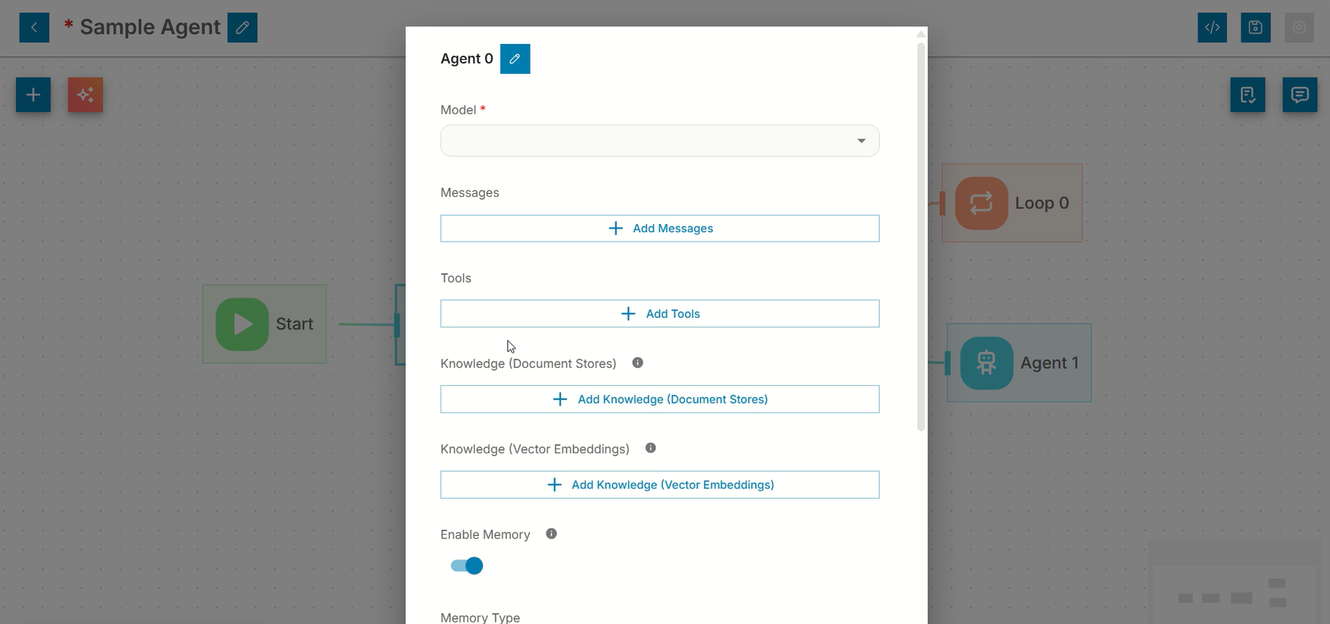
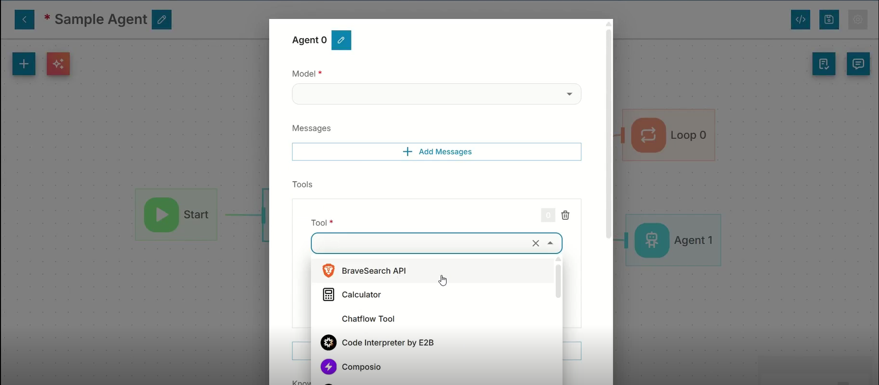
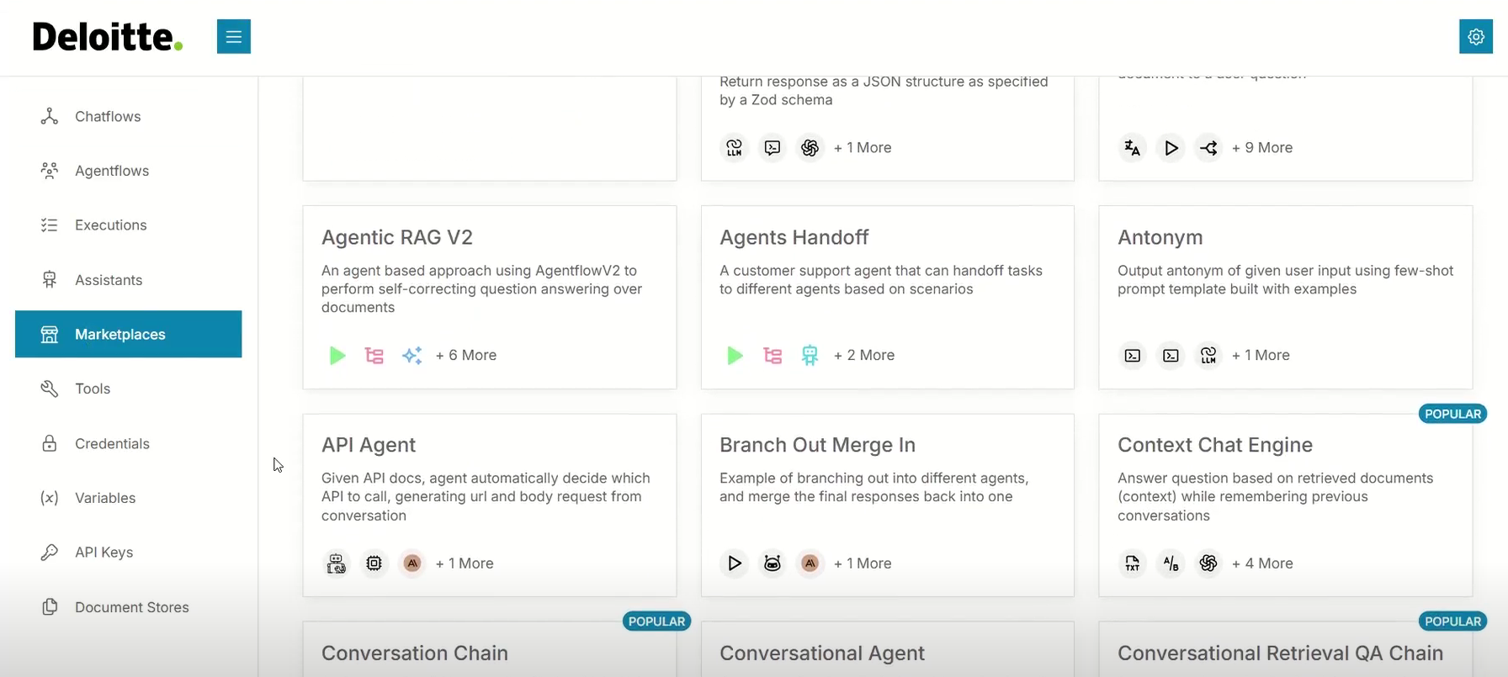
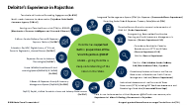
Our Value Proposition
Our differentiated capabilities position us to support the Department to achieve the intended outcomes through this assignment
Why Deloitte?
Deep Govt & Public Sector exp. – Revenue Augmentation & Land Governance Focus
Strong Multi-disciplinary Team with Relevant Experience
Strong Understanding of Working with Government of Rajasthan
Ready-to-Deploy Revenue Monitoring & Citizen Service BPR Toolkit
AI-Enabled Strategy-to-Delivery Capability
Experience supporting multiple states in national- & state-level PMUs, revenue augmentation programmes and land governance reforms, including preparation of revenue enhancement action plans for Revenue Department, tax analytics for commercial tax, system studies in land and other citizen service delivery departments, land related initiatives in urban governance, registration, regional economic planning etc.
Dedicated team comprising land administration, GIS, technology, data management, legal, and change management experts to support implementation across policy, process, and technology dimensions
Long and multi-year experience in multiple departments of Government of Rajasthan including finance, CMO, commercial tax, mining, education, health, DoIT&C etc. in areas of programme management, monitoring, tax analytics, training, public procurement, budgeting, decentralized participatory planning, revenue enhancement etc.
Readily available templates, formats and analytical frameworks for revenue target setting and monitoring, performance monitoring for central schemes, system studies etc. drawing on our experience in Assam, Chhattisgarh and other states for similar assignments which can be easily replicated for Rajasthan
Proven ability to translate government priorities into KPIs, dashboards, SOPs and review mechanisms, leveraging Deloitte’s GenW.AI suite to enable intelligent dashboards, digital workflows and AI agents for workflow automation

Slide 12
3. Delivery framework, methodology & workplan

Slide 13
Our Implementation Framework
Delivery Lifecycle
Foundational Enablers
Diagnose
Design
Deliver
Identify gaps and opportunities
Design actionable reforms and mechanisms
Drive implementation and monitor progress
Programme Management
Structured approach, tools and support
01
Analyse State & district revenue performance and key revenue sources
Assess performance of Rajasthan in various land-related indices/ schemes
Assess land service processes, policies and collection mechanisms
Map key citizen services and identify bottlenecks, leakages and delays
Assess existing IT systems, data and inter-departmental linkages
Benchmark Rajasthan against other States and good practices
Identify and prioritise revenue enhancement opportunities & quick wins
Design simplified processes and SOPs for services
Develop policy/regulatory reform recommendations
Define digitalisation, automation and API integration requirements
Establish district targets and KPIs
Develop dashboard for revenue, SASCI/DILRMP progress tracking
Support implementation of priority revenue enhancement measures
Roll out SOPs and process improvements
Drive district-level SASCI/ DILRMP milestone achievement and claims
Track revenue through dashboards
Conduct periodic State and district performance reviews
Assist preparation of documents for legislative changes
Provide periodic analysis and continuous technical support
Stakeholder Engagement
Structured consultations, coordination
02
Data & Analytics
Data-driven insights and benchmarking
03
Technology & Digital Enablement
Digital tools, dashboards
Diagnostic & priorities - gaps in policies, processes, systems
Policy recommendations, SOPs & institutional framework
Data-led governance - timely interventions and continuous improvement
04
Deloitte’s Value Addition: Blueprint for an integrated land governance system

Slide 14


Detailed Methodology: Revenue Analysis and Enhancement
DIAGNOSE
DESIGN
DELIVER
POTENTIAL SOURCES OF REVENUE
Land Tax
Mutation
Partition
Conversion
Settlement
Certified copy of RoR
Demarcation
1
Map revenue sources, charges, collection etc. and disaggregated trend analysis
1
Build forecasting models and set district baselines, targets, and timelines
1
Operationalise revenue collection and SASCI/ DILRMP monitoring dashboards
2
SASCI/DILRMP baseline assessment, performance and fund potential
2
Design procedural interventions for assessment, collection and recovery
2
Continuously identify and track revenue-enhancement cases and collections
3
Benchmark fee structures, collection mechanisms and performance across comparable states
3
Define dashboard KPIs, reports and SASCI/DILRMP milestone framework
3
Prepare quarterly revenue analysis and performance reports for HQ
4
4
Review field performance and recalibrate targets and interventions
TOOLS & ENABLERS
DELIVERABLES
Revenue monitoring framework
Quarterly performance reporting templates
T+6 weeks
T+12 weeks
T+4 to T+48 weeks
Diagnostic Assessment Report on revenue enhancement, trends, potential gaps and good practices
Dashboard for monitoring revenue collection and related indicators
Quarterly revenue analysis, identification of revenue cases and reporting to HQ

Slide 15
Detailed Methodology: Policy Intervention (1/2)
KEY CONSIDERATIONS
DIAGNOSE
DESIGN
DELIVER
Alternative Dispute Resolution
Revenue Judicial Services
Time-Bound Processes
Agricultural Leasing Reforms
Digital Records Framework
Event-Based Mutation
Digital Map Evidence
Revenue Litigation Reform
1
Literature Review of the existing Acts, Rules, policies, circulars and notifications
1
Evaluate benchmark provisions for applicability and fit with Rajasthan’s scenario
1
Reporting of the finalized recommendations
2
Assessing alignment of rules with administrative and field practices
2
Prioritize provisions requiring amendment, clarification or procedural alignment
2
Support drafting of amendments, Rules, policies, guidelines/ SOP etc
3
Identify outdated provisions, regulatory conflicts and implementation gaps
3
Develop comparative frameworks and translate findings into proposed reforms
3
Operationalize revised Rules through circulars and field-level guidelines
4
Benchmark regulatory provisions and best practices across comparable large states
4
Undertake stakeholder consultations to validate recommendations
4
Monitor regulatory actions and support effective implementation
TOOLS & ENABLERS
DELIVERABLES
Leveraging national and state legal frameworks
Regulatory action and compliance tracker
T+12 weeks
T+6 to T+48 weeks
Benchmark report of suitable provisions to strengthen existing Acts and Rules
Continuous technical inputs for circulars, government orders and field instructions

Slide 16
Detailed Methodology: Policy Intervention (2/2)
UP illustrates consolidation of multiple revenue enactments; Telangana illustrates replacement of an RoR framework aligned to a digital service workflow.
Uttar Pradesh - Revenue Code, 2006
Telangana - Bhu Bharati (Record of Rights in Land) Act, 2025
Why this State
UP's Statement of Objects and Reasons noted 39 revenue enactments in force
Why this State
A recent example of replacing a RoR framework while aligning legislation, Rules and digital service delivery.
What was done
Consolidated and amended land-tenure and land-revenue law in a single Code
Repealed older enactments, including the Uttar Pradesh Land Revenue Act, 1901
Brought revenue areas, authorities/courts and substantive land-revenue provisions into the Code
What was done
Replaced the Telangana Rights in Land and Pattadar Pass Books Act, 2020 with Act 1 of 2025
Established tiered appeal/revision routes across RDO, District Collector and Land Tribunal, depending on the service/order
Rules prescribe online procedures, forms and fees for RoR services
How it works
One Code carries the substantive framework and the Uttar Pradesh Revenue Code Rules, 2016 carry procedure, improving provision-wise traceability.
How it works
The Act and Rules structure the legal/service process, while Bhu Bharati provides the digital channel for RoR-related services.
Status
Presidential assent: 2012. Specified provisions commenced 18 December 2015; remaining provisions commenced 11 February 2016. Rules were notified in 2016.
Status
Act 1 of 2025 came into force on 14 April 2025 (G.O.Ms.No.36); Rules were issued the same day (G.O.Ms.No.39).
Way Forward for Rajasthan
Way Forward for Rajasthan
Prepare a provision-wise inventory of Rajasthan's Acts and Rules to identify overlap, inconsistency and redundancy before any decision on consolidation.
Align Rules with approved digital workflows where online processing is already the working practice, starting with conversion and mutation.
Sources: Uttar Pradesh Revenue Code, 2006 and Rules, 2016 (India Code); Telangana Bhu Bharati official documents; Rajasthan Revenue Department - Act and Rules repository

Slide 17
Detailed Methodology: Process Improv. in LR Management & Citizen Services (1/2)
KEY CONSIDERATIONS
DIAGNOSE
DESIGN
DELIVER
1
Prioritise high-volume land revenue and citizen-service processes for assessment
1
Define simplification principles within applicable legal, policy and system constraints
1
Validate To-Be processes with concerned departments, field units and technology teams
Statutory and Regulatory Compliance
End-to-End Process Coverage
Field-Level Operational Viability
Alignment with Existing IT Ecosystem
Cross-Departmental Integration
Land Data Repository
Single Window Land Services Gateway
Interoperable and Standardized Data Framework
2
Map As-Is workflows, roles, approvals, documents, timelines and system touchpoints
2
Design To-Be workflows with fewer hand-offs, defined controls and reduced physical visits
2
Prepare SOPs, responsibility matrices, service standards and escalation mechanisms
3
Conduct process walkthroughs with headquarters, field units and system stakeholders
3
Rationalise forms, documents, approvals, roles, service timelines and escalation paths
3
Develop a prioritised /integrated digitalisation roadmap with dependencies and implementation actions
4
Identify bottlenecks, duplication, pendency drivers and avoidable citizen touchpoints
4
Identify automation, integration, alerts, tracking and exception-handling requirements
4
Establish service KPIs, monitoring arrangements and capacity-building requirements
TOOLS & ENABLERS
DELIVERABLES
Process Inventory
Time & Pendency Analysis
Automation Assessment
Service KPI Dashboard
T+8 weeks
T+14 weeks
As-Is assessment of priority land revenue and citizen-service processes
To-Be processes, SOPs and prioritised digitalisation roadmap, integrated land governance ecosystem

Slide 18
Detailed Methodology: Process Improv. in LR Management & Citizen Services (2/2)
These examples simplify citizen service by removing avoidable steps and enabling digital status/record access rather than adding another channel alongside the existing process.
Madhya Pradesh - Cyber Tehsil
Maharashtra - MahaBhumi and e-Ferfar
Why this State
A neighbouring State that combined a legal amendment with a digitally integrated mutation workflow.
Why this State
A strong example of self-service access to land records and visible mutation status through the MahaBhumi ecosystem.
What was done
Amended the Madhya Pradesh Land Revenue Code, 1959 to create Cyber Tehsil jurisdiction
For eligible undisputed transfers, enabled mutation to proceed without a separate application
Integrated registration, land-record and revenue-case systems to support paperless/faceless processing
What was done
Provides online access to 7/12, 8A and mutation/Ferfar services through the MahaBhumi / Bhulekh ecosystem
Issues digitally signed extracts online; the official portal states these are valid for official and legal purposes
Enables citizens to track mutation entries/status electronically
How it works
After registration, eligible undisputed whole-property transactions can trigger mutation; notices/objections and disposal are handled digitally.
How it works
Citizens can view/download land records and track mutation status online, reducing routine office visits.
Status
Pilot in two districts from June 2022; statewide rollout on 29 February 2024. Launch reporting indicated a 15-day timeline for eligible transfers.
Status
In operation. In December 2025, digitally signed 7/12, 8A and Ferfar extracts were declared valid for government, banking, loan and judicial use.
Way Forward for Rajasthan
Way Forward for Rajasthan
Identify undisputed mutation categories in Rajasthan that can be system-triggered on registration and pilot them in selected tehsils.
Publish a single citizen-readable case status with the reason for hold/objection and case age against the service standard.
Sources: 16th Finance Commission study - Madhya Pradesh; Cyber Tehsil launch reporting (ANI); MahaBhumi / Digital Satbara / e-Ferfar, Government of Maharashtra; News on AIR, 4 Dec 2025

Slide 19
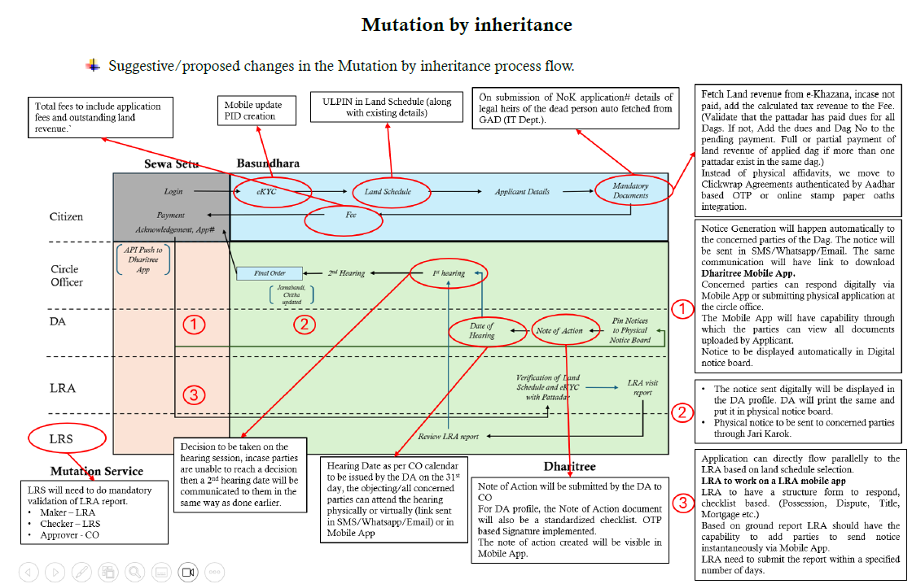
Detailed Methodology: Illustrative Business Process Improvement

Slide 20
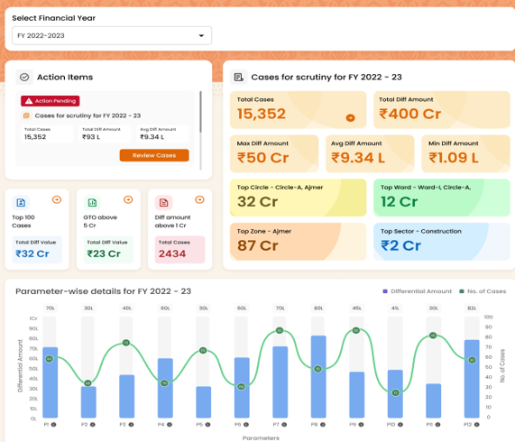
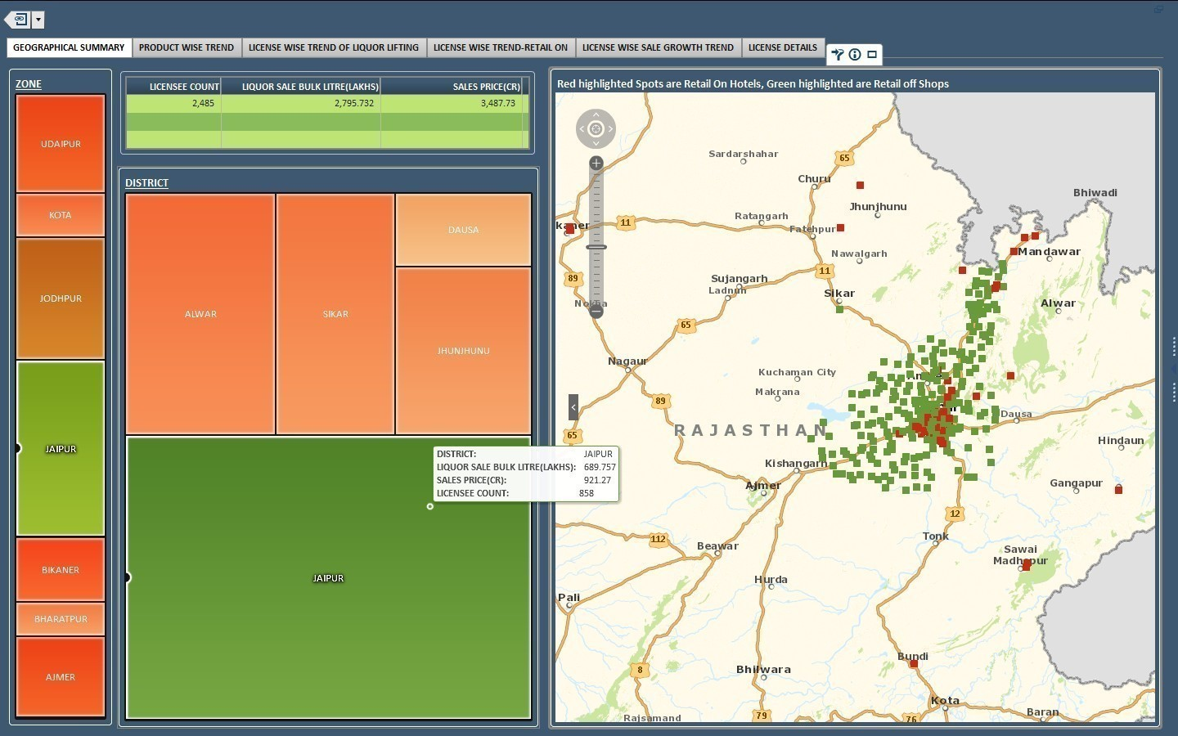
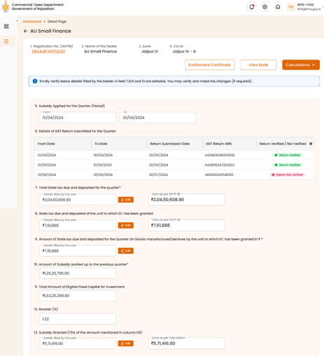
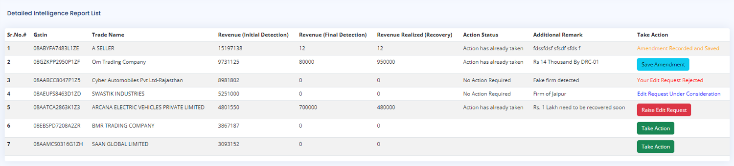
Integrated Land Governance System
DATA
EXCHANGE
LAYER
(epanjiyan, RRCMS, DMG, Raj Girdwari, Raj Forest, FMDSS, RIPS)
Sources
Data Integration Layer
User Layer
External
Mobile App
Operational Alerts / Field Reports
Kiosk
Single Land Gateway
GIS Dashboard
Registration & Stamp
Encrypted Channel
Role Based Access
Single Sign On
Audit Trail
Security Layer
Agriculture
Land Intelligence Layer
Forest
Mining
Land Revenue – Valuation Analytics, Revenue Leakages, Identification of new revenue streams, Third party intelligence
Land Asset Intelligence – Land Availability, Encroachment detection, Automations, Comparative Analysis, Fraud Detection
Land Justice – Litigation Analytics, Cases pendency analysis, Ageing report, Case status
Industry
Local Bodies
Treasury
Application Layer
Panchayati Raj
Citizen Services
Justice Services
Land Event Ledger
Rules & WF
Administration
UDH
One Land Gateway
Search Parcel
GIS Based Search
Case Status
Grievances System
RRCMS
Litigation
Stay Orders
Case Status
Case Pendency's
Registration
Mutation
Conversion
Court Order
Acquisition / Status
Risk Scoring
SLA Management
Auto Mutation
Approval Flows
Dashboards
Govt Land Encroachment
Planning
Land Allotment
Others
Internal
Apna Khata
Parcel Master Registry
Legal
Spatial
Fiscal
Third Party Integration
Bhu Naksha
Data Layer
ULPIN/Khasra/ Parcel ID
Land Classification/Area
Map
Geometry / Coordinates
Mutation
Ownership
Inheritance
Partition
Court Orders
Case Status
RoR
Cadastral Map
GIS Layers
Geo-reference
Satellite
Survey
Land Use
Land Revenue
Conversion Fee
Lease Premium
Arears
Registration Fee and Stamp Duty
Forest and Mining Boundaries
Third Party GIS Layers
Land allotment Status
Revenue Court Registers
Conversion Workflow
Internal Observation Records
I

Slide 21










Deloitte Value Addition: Achieving "One Parcel, One Truth“ through automated, frictionless ecosystem integration
Illustrative
eDharti:
Automated Mutation
Instantly Updates Core Record
Apna Khata:
The Textual Record
The Record Truth
The Workflow Truth
-Paperless submissions & digital verification
-Electronic approvals via SSO
-Eliminates manual Patwari delays
-Citizen portal for real-time Jamabandi (RoR)
-Legally valid, e-Signed documents
Synchronises
Spatial Data
Defines Legal
Ownership
ULPIN
Triggers
Auto-Mutation
Auto valuation of property
(Unique Land Parcel
Identification Number)
ePanjiyan:
Property Registration
BhuNaksha:
Cadastral Mapping
The Transaction Truth
Defines
Physical
Reality
The Spatial Truth
End-to-end digitization of all types of deeds
GIS-based property valuation (DLC Rates)
-GIS-enabled geo-referencing
-Standardises historical measurement
21

Slide 22
Project Work Plan
12-month TSU implementation period | T to T+48 weeks
Workplan
The workstreams progress in parallel, with early diagnostics informing reform design, digital enablement and continuous implementation support
WORKSTREAM
KEY ACTIVITIES
M1
M2
M3
M4
M5
M6
M7
M8
M9
M10
M11
M12
OUTPUT / DUE
A. MOBILISATION
& GOVERNANCE
• Kick-off, mobilisation & data access
• Detailed work planning & stakeholder schedule
• Coordination, progress and quarterly reviews
Inception and
approved work plan
T+2 weeks
Support / monitor →
B. REVENUE ANALYSIS
& ENHANCEMENT
• Revenue data validation and diagnostic
• Benchmarking, opportunities & target framework
• Dashboard and periodic revenue reviews
Diagnose
Diagnostic: T+6
Dashboard: T+12
Design / develop
Support / monitor →
C. POLICY
INTERVENTION
• Regulatory inventory and provision-gap review
• Inter-state benchmarking and consultation
• Drafting support for amendments and related documents
Diagnose
Benchmark report:
T+12 weeks
Support: T+48
Design / develop
Support / monitor →
D. PROCESS IMPROVEMENT
& CITIZEN SERVICES
• As-Is mapping and bottleneck Diagnosis
• To-Be workflows, SOPs and service standards
• Implementation and service-KPI monitoring
Diagnose
As-Is: T+8
To-Be / roadmap:
T+14 weeks
Design / develop
Support / monitor →
E. DATA INTEGRATION
& IT SYSTEMS
• Application, data and user-gap Diagnose
• Data standards, reconciliation and API design
• Functional enhancement and rollout support
Diagnose
API framework &
roadmap
T+24 weeks
Design / develop
Support / monitor →
F. CONTINUOUS SUPPORT
& CAPACITY BUILDING
• SASCI, action, risk and issue tracking
• Training, guidance and knowledge transfer
• Periodic reporting and institutional handover
Diagnose →
Continuous support
and handover
T+48 weeks
Design / develop →
Support / monitor →
KEY ToR
MILESTONES
T+2
T+12 / T+14
T+48
OVERALL OUTCOME
Inception
Dashboard, policy & To-Be
Handover
Data-led revenue management, simplified services and integrated digital systems
◆ Deliverable due point
T+6 / T+8
T+24
Diagnostic & As-Is
API framework

Slide 23
4. Team Overview

Slide 24

ASHWIN TIWARI
18+
YEARS
OF EXPERIENCE
Insert
Photo
Team Lead
Core Competencies
Ashwin brings 18+ years of experience in building extremely large Data Warehouses, BI & Analytics solutions for Telecom, Banking and Govt. Financial Services. With expertise in Analytics, Fraud Framework and Financial Crime Monitoring Analytics, he has been a pioneer in introducing the concept of tracking frauds happening and subsequent recovery of evasion amounts. He has worked in a Techno-Functional role and has extensively worked on implementation of Revenue Enhancement and Advanced Analytics solutions for multiple clients. He holds a B.E. degree in Computer Science from ACEIT, University of Rajasthan. An excellent leader and team player with a proactive personality and commitment to deliver quality work on schedule.
Fraud Analytics & Financial Crime Monitoring
Revenue Enhancement & Tax Fraud Detection
Key Departments
Data Warehousing, ETL & BI Architecture
Finance Department, Government of Rajasthan: CoERRA, Revenue-earning departments – Technical Support Unit, Analytics CoERRA ( Mining, Excise, Registration & Stamps, Transport, Commercial Tax Department, SDRI and DoIT&C)
State Crime Records Bureau (SCRB), Rajasthan Police
Jammu & Kashmir Bank – Automated Data Flow
Advanced Analytics & Machine Learning Models
Analytics CoE Design & Team Leadership
Area of
professional
experience
18+ years of experience in large-scale Data Warehousing, BI & Analytics for Telecom, Banking and Govt. Financial Services.
Fraud Framework & Financial Crime Monitoring Analytics – tracking frauds and subsequent recovery of evasion amounts.
Revenue Enhancement and Advanced Analytics solution implementation in a Techno-Functional role for multiple clients.
Designed end-to-end data flow architecture from ETL to BI; developed rules and ML models to predict potential fraudulent activities.
Work estimation, allocation, execution and delivery ownership of analytical solutions with stakeholders.
Technical Skills
RDBMS: Oracle 10g / 11g, DB2, Microsoft SQL Server
Data Management & Quality: SAS DI Studio, Data Management Studio, Enterprise Guide, SAS Management Console
Visualization: SAS Visual Analytics, Web Report Studio, BI Dashboards, OLAP Cube Studio, Tableau
Fraud & Finance Suite: SAS Fraud Framework, SAS FCM, SAS ALM, SAS Financial Management
Other: SAS Marketing Automation Tool
Clients
handled
Commercial Taxes Department, Government of Rajasthan
Technical Support Unit, Government of Rajasthan
State Directorate of Revenue Intelligence, Rajasthan
State Crime Records Bureau, Rajasthan Police
Jammu & Kashmir Bank
Telecom, Banking and Govt. Financial Services clients
Key Responsibilities for this assignment
Design the source integration strategy and approach, and implement the approach to integrate different systems. Interact with departmental stakeholders to finalise functional requirements; define, prioritise and delegate tasks with work estimation, allocation, execution and delivery ownership. Create and execute project work plans and revisions as appropriate to meet changing needs, review deliverables, and validate the developed analytical solution with presentation to concerned stakeholders.

Slide 25
Rahul Galtwani
Insert
Photo
Policy Expert
11+
YEARS
OF EXPERIENCE
Government Advisory and Public Sector Consulting professional with 11+ years of experience supporting State and Central Government institutions in policy implementation, governance and programme management. Experienced in reviewing Government guidelines, circulars, orders, notifications and scheme provisions, identifying gaps and suggesting improvements. Worked on skill development and employment-related policy initiatives, including policy research and implementation support. Experienced in benchmarking processes and developing SOPs, operational guidelines and implementation frameworks. Regularly worked with Government departments and senior officials on reviews, consultations and decision-support assignments.
Core Competencies
Policy Research & Benchmarking
Compliance & Governance
Key Departments
Ministry of Skill Development & Entrepreneurship (MSDE), Government of India.
Ministry of Rural Development (MoRD), Government of India
Planning Department, Government of Rajasthan.
Department of Skill, Employment & Entrepreneurship, Government of Rajasthan.
National Council for Vocational Education and Training (NCVET), Government of India.
National Skill Development Corporation (NSDC)
SOP & Operational Guideline Development
Monitoring & Analytical Reporting
Compliance & Governance
Area of
professional
experience
11+ years of experience in Government advisory, policy implementation, programme management and governance.
Experience across Skill Development, Employment, Social Inclusion, Livelihoods and Women Empowerment programmes.
Reviewed Government provisions and supported development of guidelines, SOPs, implementation frameworks and process improvements.
Managed 8 major Government programmes with an annual portfolio exceeding ₹200 crore across Rajasthan.
Government Programme Management
Technical Skills
Clients
handled
Rajasthan Skill & Livelihoods Development Corporation
Directorate of Technical Education (it is)
Employment Dept.
Rajasthan Council For Vocational Education & Training.
Vishwakarma Skill University
Project Monitoring & Reporting .
Data Analysis & Performance Monitoring.
MIS & Dashboard Reporting.
AI-assisted Research & Documentation
Microsoft Excel (Advanced)
Key Responsibilities for this assignment
Review and analyse Government Acts, Rules, policies, guidelines, circulars, orders and notifications with focus on implementation provisions .Support drafting and revision of amendments, notifications, Government Orders, guidelines, SOPs and related policy documents. Undertake policy research and stakeholder consultations and translate findings into concise recommendations and decision-support notes.

Slide 26
Business Process Expert
Research Analyst
Insert
Photo
Parul Tiwari*
Insert
Photo
Prerna Singh
7+
YEARS OF EXP.
3
YEARS OF EXP.
Business Process Expert | Senior Consultant
Research Analyst | Consultant
Parul has over 7 years of experience in Public Finance, Policy Advisory, Governance Reform and Development Consulting. She holds a Master of Commerce (Applied Economics) and a Bachelor of Commerce from University of Lucknow. Languages: Hindi, English.
Prerna has 3 years of experience in Public Finance Consulting, research analysis, data analysis, framework development and client coordination. She holds a Master's Degree (MA) in Economics from the Delhi School of Economics and a Bachelor's Degree (BA Hons.) in Economics IPCW from the University of Delhi.
Core Competencies
Core Competencies
Public Finance & Macro-Fiscal Modelling
Process Innovation & Re-engineering
Revenue Enhancement & Data Analytics
Tax Compliance & Revenue Intelligence
Analytics, BI & Impact Assessment
Stakeholder & Program Management
Fiscal Policy & Economic Analysis
Governance & Institutional Strengthening
Skills & Technologies
Skills & Technologies
Public Finance: Revenue Forecasting, Macro-Fiscal Modelling, Debt Sustainability Analysis, Outcome-Based Budgeting, Policy Analysis, Monitoring & Evaluation, Results Framework Design, Impact Assessment
Process Innovation: Lean Six Sigma (DMAIC), Business Process Re-engineering, Digital Transformation
Analytics & Tools: Power BI, SQL, Advanced Excel, SPSS, STATA, EViews, Alteryx
Stakeholder Management: Government Advisory, Multilateral Engagement, Capacity Building, Program Management
Domain Expertise: Revenue Enhancement and Data Analytics, Tax Compliance and Revenue Intelligence, Fiscal Policy and Economic Analysis, Regulatory and Policy Reforms, Governance and Institutional Strengthening, Citizen Service Delivery Improvement, Monitoring & Performance Management Frameworks, Business Process Re-engineering, Digital Transformation
Technical Skills: RStudio, SQL, MS Excel, PPT, Word, GenAI, Data Analytics & Dashboarding, Power BI, Policy Research, Financial and Economic Modelling
Key Departments
Key Departments
Sectorial Group of Secretaries (SGoS) & Finance PMU
Mines & Petroleum Department, Government of Rajasthan
Project Management Unit, Government of Rajasthan
Government of Uttar Pradesh
Technical Support Unit, DoRI&EO
COERRA – SDRI, Government of Rajasthan
Chief Minister's Office, Rajasthan
Project Management Unit, Government of Rajasthan
Professional Experience
Professional Experience
Sectorial Group of Secretaries (SGoS) & Finance PMU: Led Finance & Mines workstreams; developed MTFF fiscal and revenue projections.
Viksit Rajasthan @2047 – Mines & Petroleum: Supported sector roadmap and DMFT governance & utilization reforms.
Project Management Unit, Government of Rajasthan: Led 16th FC submissions, fiscal analysis, OOB reforms and PFMTI evaluations.
Uttar Pradesh – One Trillion Dollar GSDP Vision: Conducted revenue augmentation and inter-state benchmarking for excise reforms.
Rajasthan Transparency in Public Procurement Act & Rules: Developed training modules and capacity-building programs for government procurement.
* Currently engaged in another project will be transferred upon relevant approvals.
Technical Support Unit, DoRI&EO: Led revenue analytics and leakage detection across GST, Mining, Transport, Excise and Registration.
COERRA–SDRI – Departmental Support: Analyzed Excise, GST & NDPS regulations and developed RSBCL's monthly reporting framework.
Chief Minister's Office: Conducted scheme performance and AS-IS assessments to improve outcomes.
Green Credits Initiative: Designed Rajasthan's Green Credit framework and end-to-end credit lifecycle.
Redrafting of Rajasthan Excise Rules: Rationalized the Excise Act and 23 Rules and benchmarked inter-state regulatory practices.
Project Management Unit, Government of Rajasthan: Supported 16th Finance Commission submissions, including fiscal analysis, projections and State Memorandum.

Slide 27
Data Analytics Expert - 1
Data Analytics Expert - 2
Insert
Photo
Payal Sharma
Insert
Photo
Ajay Singh Nathawat
9+
YEARS OF EXP.
5+
YEARS OF EXP.
Senior SQL / Database Developer
Data Analytics Expert
B.Tech in Computer Science from Vivekananda Institute of Technology, Jaipur. SQL Developer with 9+ years of progressive experience across database architecture, complex T-SQL/PL-SQL development, performance tuning and cross-database data migration, with a strong track record across enterprise and government-sector projects.
B.Tech, Electronics & Communication Engineering — Jaipur Engineering College and Research Centre, Jaipur (2014–2018). Certification: Advance Microsoft Excel. Skilled in using Excel, Power BI, Pivot Tables and Google Data Studio to analyse data and generate meaningful insights.
Core Competencies
Core Competencies
DB Architecture
T-SQL / PL-SQL
Performance Tuning
ETL & Migration
Data Analysis & Business Intelligence
UI/UX & Product Design
Skills & Technologies
Business & Functional Analysis
Project & Stakeholder Management
Databases: MS SQL Server, IBM DB2, PostgreSQL, MySQL, PL/SQL — database design, complex queries, optimization
ETL & Data Migration: Data migration, data mirroring, automated data-population scripting, cross-database project migrations, data pipeline design
Performance, Cloud & Tools: Performance tuning & optimization, troubleshooting, backup & recovery strategy, high-availability design; AWS (working knowledge); MSBI, SSIS, SSRS, SSAS (learning); Excel, Word, MS Access
Skills & Technologies
Data Analysis & Analytics: Data Analysis, Exploratory Data Analysis (EDA), Data Interpretation, Complex Data Analysis, Data-Driven Decision Making, Business Intelligence
UI/UX & Product Design: Wireframing, Mock-ups, User Journey Mapping, Information Architecture, Prototyping, Usability Analysis, User-Centric Design
Business & Functional Analysis: Requirement Gathering, Business Process Analysis, Functional Specifications, Use-Case Analysis, Policy Compliance, Solution Design
Project & Stakeholder Management: Agile Methodologies, Scrum, Project Scope Assessment, Stakeholder Management, Cross-Functional Collaboration, Government & Private Sector Solutions
Professional Experience
Associate Team Lead, Nagarro, Jaipur | May 2021–Current: Own database architecture end-to-end; design optimized, scalable structures from client requirements. Build monitoring, tuning and backup/recovery procedures; optimize complex T-SQL queries, views and stored procedures across multi-database environments; manage large PostgreSQL and IBM DB2 datasets with automated ETL for weekly file population; deliver migrations, mirroring and cross-system transfers; resolve bottlenecks via table partitioning; author business reporting and documentation.
Senior Software Engineer, NIC (Velocis Pvt. Ltd.) | Apr 2020–May 2021: Created system monitoring, recovery, backup and optimization procedures; maintained complex T-SQL queries, views and stored procedures in a multi-database environment; deployed and tuned applications and documented business reports.
Software Engineer, NIC (SISL Pvt. Ltd.) | May 2017–Mar 2020: Finance-domain government projects — GST, e-GRAS and RBI e-Kuber. Designed stable databases, gathered requirements and built extraction processes using tables, triggers, stored procedures, views, indexes and joins; applied R for data prediction.
Junior Software Engineer, UMC Technologies (Celeste) | Aug 2016–May 2017: Student-education data processing for RUHS Jaipur, ICAR and West Bengal Education Department; built an online form-filling application, rules engines for result processing and counseling, and complex stored procedures.
Key Organisations
Ernst & Young LLP, Jaipur
Government of Rajasthan initiatives
Biz4Group LLC, Jaipur
Finance Department, Government of Rajasthan
Professional Experience
Ernst & Young LLP, Jaipur | Feb 2023–Present: Progressed from Associate Consultant to Senior Consultant, delivering data analysis, business analysis, digital transformation and project management solutions for Government of Rajasthan initiatives. Key work includes MIS analysis and dashboards for policy and revenue decision-making, functional research and module design for the Karmik Integrated HR & Office Management System (ISMS), VAT IT system assessment, workflow analysis and testing, and conceptualization of digital platforms including IRMS, RajVyapaar, Tax-Mitra, Faceless Tax Administration and GST initiatives.
Biz4Group LLC, Jaipur | Aug 2021–Feb 2023: Worked as Business Analyst and IT Business Analyst & Project Coordinator, managing project planning, requirements gathering, SRS/FRS/SOW documentation, wireframes, flowcharts, project estimates and client communications. Coordinated cross-functional teams, tracked progress using Jira and Trello, managed risks and milestones and supported Agile delivery as a Scrum Master. Achievements: Received the Client Extraordinaire award for outstanding contribution to a successful Finance Department, Government of Rajasthan pursuit.

Slide 28
5. Our Experience

Slide 29
Our Experience
S. No. | Project Name & Client | Sector / Department | Project Duration | Revenue Analysis & Enhancement | Policy / Regulatory Review | Land Governance & Revenue Administration | Process Re-engineering & SOP Development | Citizen Service Improvement | Data Integration / API Framework | IT Systems Assessment & Digitization Roadmap | Dashboard / Analytics / MIS
1 | Preparation of Scientific Framework of Market Value Management System for Directorate of Registration and Stamp Revenue Directorate of Registration and Stamp Revenue, Government of West Bengal | Registration & Stamp Revenue | 01/2019–10/2024 | ✓ | ✓ | ✓ | ✓ | ✓ | ✓ | ✓ | ✓
2 | Revenue Enhancement Action Plan – Phase II Directorate of Land Records, Government of Assam | Land Records & Surveys | 02/2025–Ongoing | ✓ | ✓ | ✓ | ✓ | ✓ | ✓ | ✓ | ✓
3 | Mizoram Public Resource Management Program (MPRMP) – MIS Consultancy and Budget Reform for Government Department | Finance, Land Revenue & Settlements, Taxation, Health, Education, PHED, Accounts & Treasuries | 01/12/2011-01/02/2015 | ✓ | ✓ | ✓ | ✓ | ✓ | — | ✓ | ✓
4 | Revenue Augmentation Finance department, Government of Assam | Revenue & Disaster Management | 03/2021–10/2021 | ✓ | ✓ | ✓ | ✓ | ✓ | — | ✓ | —
5 | Institutional Assessment of the CTD including GST Readiness Assessment and Developing a Road Map Commercial Taxes Department, Government of Rajasthan | Commercial Taxes Department | 04/2017–04/2019 | ✓ | ✓ | — | ✓ | ✓ | — | ✓ | ✓
6 | Hiring of Expert/Consultant for TSU at CTD Commercial Taxes Department, Government of Rajasthan | Commercial Tax Department | 03/2024–03/2026 | ✓ | ✓ | — | ✓ | ✓ | ✓ | ✓ | ✓
7 | Technical Support Unit - Directorate of Revenue Intelligence and Economic Offences (DRI&EO), Government of Rajasthan | Revenue Intelligence and Economic Offences | 07/2025–03/2026 | ✓ | ✓ | — | — | ✓ | ✓ | ✓ | ✓
8 | Project Management Unit - Finance Department, Government of Rajasthan | Finance Department | 03/2024-09/2025 | ✓ | ✓ | — | ✓ | — | — | — | —

Slide 30
Our Experience – Detailed Activities across Projects (1/4)
Land Valuation & Revenue Enhancement
Preparation of Scientific Framework of Market Value Management System for Directorate of Registration and Stamp Revenue, Government of West Bengal
Directorate of Registration and Stamp Revenue, Government of West Bengal, India | 01/2019–10/2024
Phase I- Design of Scientific Valuation framework
Analysis and framework
Phase II & Phase III
R, Tableau and Python used on 2009-2018 transaction data; reclassification of land use; benchmarking of valuation procedures, stamp duty, registration fees, depreciation and rebate; ready reckoner; formula-based market valuation framework; parameters, weights and stakeholder consultations.
Pilot and testing using field and GIS data; consolidated market value database and clusters/zones; optimization of land uses and conversion ratios; FRS for IT tool; cleaning and structuring GIS data; clustering using updated MVDB; update of existing formula using new parameters.
As-Is analysis of existing methodology of valuation of immovable properties; study of acts and rules; analysis of information exchange and dependency between Directorate of Land Reforms and DRSR; analysis of land use classifications, conversion ratios, MVDB and historical transaction data.
Revenue Enhancement Action Plan – Phase II
Directorate of Land Records & Surveys etc., Government of Assam | 02/2025–Ongoing
Stage 1
Revenue areas
Stage 2
Scientific zonal valuation framework; as is assessment of zonal value determination; best practice study; parameter identification; data analysis, cleaning and structuring; statistical models; FRS and draft SRS; prototype application.
As-is assessment of policies, processes, charges, monitoring mechanisms and revenue generation practices for tea, mining, and oil & gas industries; assessment of instruments under stamp duty and registration legislation.
Customization for two pilot districts; live testing; variance analysis; methodology for periodic updates of base land values; district-specific parameters; project management and technical guidance for system development, integration, piloting and go-live support.

Slide 31
Our Experience – Detailed Activities across Projects (2/4)
Revenue & Tax Administration
Revenue Augmentation in Revenue & Disaster Management Department in Government of Assam
Government of Assam | 03/2021–10/2021 | As lead firm
Revenue sources and processes
IT system and best practices
Recommendations
Study of various sources of revenue and corresponding policies and acts; process of collection of land revenue and stamp duty & registration fees; process of zonal valuation of land across districts.
Study of functions available in the current IT system related to the Revenue Department; study of best practices for processes and rates adopted for collection of stamp duty & registration fees and land revenues.
Measures of revenue enhancement from registration fees and stamp duty as well as land revenues; recommendations for smoother processes leading to better service delivery; standardization of government assessed valuation of land based on scientific methodology; Revenue Enhancement Action Plan.
Institutional Assessment of the Commercial Taxes Department (CTD) including GST Readiness Assessment and Developing a Road Map
Government of Rajasthan | 04/2017–04/2019
GST transition
Audit and training
Organizational support
Assisting CTD in smooth transition to GST in terms of organizational and operational strengthening; checklist of transitional issues; day-to-day technical support on GST Acts and Rules, commodity classification, representations and GST Council meetings.
Risk based GST Audit Manual; Training Need Assessment; three-year Training Strategy; Medium-Term Training Plan; Training Courseware; training of CTD officials, Master Trainers and practical computer-based training.
Awareness sessions on GST; support in Organizational Restructuring of CTD by doing workload assessment and mapping; preparation of a roadmap for Establishment of Tax Analytic Unit.

Slide 32
Our Experience – Detailed Activities across Projects (3/4)
Tax Analytics, Systems & Revenue Intelligence
Hiring of Expert/Consultant for TSU at Commercial Tax Department
Commercial Tax Department, Jaipur, Rajasthan | 03/2024–03/2026
Module 1: Tax Analytics
Module 1: Data and MIS
Module 2: Integrated Commercial Taxes Management System
Reports and dashboards analyzing GST compliance, liabilities, input credit and turnover; use cases for fake/suspicious taxpayers; GST Analytics Dashboard; key revenue-contributing sector analysis; Economic Indicators Dashboard.
Regular MIS reporting by extracting API data; revenue trends, zonal performance, return compliance and sectoral growth; data extraction and cross-validation from GST Prime, BO portal and E-Way bill portal.
Stakeholder workshops, RTM and roadmap; project plan, FRS, SRS and design documents; development of modules; testing and UAT; security audit; integrations; training; POC, Pilot run, Go-Live, data migration and post implementation support.
Technical Support Unit (TSU) for the Directorate of Revenue Intelligence and Economic Offences (DRI&EO), Government of Rajasthan
Directorate of Revenue Intelligence and Economic Offences (DRI&EO), Jaipur, Rajasthan | 07/2025–03/2026
Data Repository and integration
Analytics and risk
Revenue intelligence
Data Repository integrating data from multiple departments and agencies; automated and periodic data exchange; integrated dashboard linking PAN and GSTIN across 5 departments; APIs, web crawling and flat files.
Rule-based and analytics-driven use cases; analytics models, fraud detection models and risk models; predictive and risk analysis; risk profiling of traders, licensees, lessees and taxpayers.
Detect evasion, fraud and revenue leakages; identify revenue opportunities; data-driven insights for fraud investigation teams; impact of regulations on revenue collection; benchmarking of revenue policies; training and capacity-building programs.

Slide 33
Our Experience – Detailed Activities across Projects (4/4)
Financial Governance and Reform: PMU Contributions; Tax Analytics, Systems & Revenue Intelligence
Project Management Unit for Finance Department, Government of Rajasthan
Finance Department, Government of Rajasthan | India, Rajasthan | 03/2024–09/2025
Process
Key Tasks
Preparation of the Memorandum for the 16th Finance Commission
Preparation of the Green Credit Policy
Outcome-Output Budget framework and State-wide roll-out
Drafted Finance Departments chapter for Viskit Rajasthan 2047 document
Drafting of the 7th State Finance Commission Interim Report (2025-26)
Support to SDRI – review of revenue Acts, RSBCL reporting and data analytics
As-is assessment of the State’s fiscal and regulatory framework
Research, benchmarking and data analysis
Stakeholder consultations across departments
Design of frameworks, policies and revised rules
Pilot, formalisation through circulars and capacity building
State-wide roll-out with monitoring and evaluation
Mizoram Public Resource Management Program (MPRMP) – MIS Consultancy and Budget Reform for Government Department
Asian Development Bank | India, Mizoram | 12/2011–02/2015
Process
Key Tasks
Detailed assessment of processes in government operations
Identification of process improvements and functional gaps
Design of the management information system
Assistance in procurement of the envisaged system
Training of departmental staff and officials on the MIS
Overall program management
Property revenue process studies and land records digitization strategy – Land Revenue Department
MTEF preparation and capacity building – Health Department
Tax administration review and revenue management gap assessment – Taxation Department
Budget preparation, resource allocation and fund management assessment – Finance Department
Treasury, GPF, pension and payroll IT enablement – Accounts & Treasuries Department
Public expenditure review and preparation of the Core Investment Plan (CIP)

Slide 34


Slide 35
Deloitte’s Experience in Rajasthan
Technical and Functional Consulting Engagements (DoIT&C)
MaaY- Health Insurance Implementation (Rajasthan State Health Assurance Agency (RSHAA))
Integrated Tax Management System (ITMS) for Rajasthan (Commercial Taxes Department)
Re-writing Excise Rules & Rajasthan Treasury Rules/Manual (DTA)
Setting up of Technical Suport Unit (TSU) for DRI&EO
(Directorate of Revenue Intelligence and Economic Offences)
Technical Support Group for smooth implementation of IEMS 2.0 (Excise Department)
Deloitte has supported GoR in preparation of the Viksit Rajasthan @2047 vision – giving Deloitte a deep understanding of the vision in the State.
Strengthening Decentralized Participative Planning and Public Investment Management in Rajasthan (Finance Department-EAD)
E-Mitra:- Service Delivery Channel & Rajasthan Payment Platform (DoIT&C)
Education: Raj NOC, Digital Library, HTE Portal, Doctor’s Registration, Kaushal Darpan (DoIT&C)
Consultancy Services for Capacity Development on RTTP Act & Rules (Finance Department-EAD)
PMU for Finance Department
Rajasthan Centre for Advance Technologies (DoIT&C)
PMU for Chief Minister Service Delivery Cell, Chief Minister Office, Rajasthan
Forest: Wildlife Surveillance & Anti-poaching System(WS&APS) & FMDSS) (DoIT&C)
Consultancy Services to Support the Finance Department to Establish the Public Finance Management Institute (Finance Department)
E-Bazaar & Rajasthan Supply & Inventory Management System (RajSIMS) (DoIT&C)
Institutional Assessment of the Commercial Taxes Department (CTD) including GST Readiness Assessment and Developing a Road Map (Commercial Taxes Dept)
RajERP, RajKAJ, Unified Portals for Urban and Industry Departments (DoIT&C)
PMU for the implementation of Viksit Rajasthan @2047 and otherr aspects, with Department of Mines & Geology, Government of Rajasthan

Slide 36
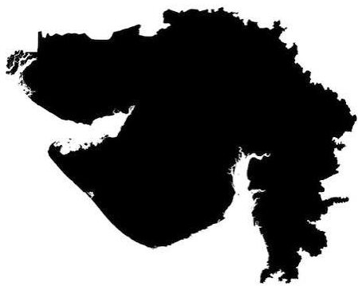
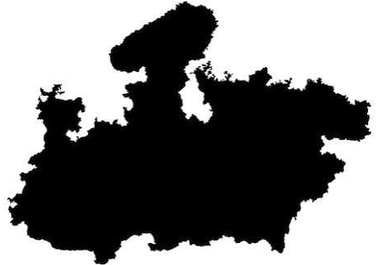
Rajasthan’s Revenue Land Revenue Collection
Land Revenue (in Rs. Cr.) – RJ vis-à-vis Select States
State | 2023–24 Actuals | 2024–25 Actuals | RJ times | LR % SOTR (2024–25)
Rajasthan | 469 | 869 | 1.00 | 0.8%
UP | 405 | 414 | 0.48 | 0.2%
Odisha | 1,123 | 785 | 0.90 | 1.4%
MP | 1,079 | 1,069 | 1.23 | 1.1%
Gujarat | 8,558 | 4,801 | 5.52 | 3.4%
Collection in RJ was among the lowest (except UP) in FY24, until enhanced collection from sale of govt. + barren land
Gujarat primarily generates additional revenue (~Rs. 3,900 cr) from conversion/sale of land from new tenure to old tenure
MP’s additional revenue is from diverted (converted) land (~Rs. 400 cr) and admin charges for land acquisition (~Rs. 170 cr)
FY25: Rs. 399 cr YoY increase
  Rs. 277 cr from sale of govt properties + Rs. 134 cr from sale of barren land
FY26: Rs. 880 cr YoY increase
  Rs. 693 cr from sale of govt properties + Rs. 60 cr from sale of barren land + Rs. 75 cr from development authorities
Both states generate significantly higher revenue from land revenue tax
(GJ – Rs. 386 cr.; MP – Rs. 194 cr.; RJ – Rs. 0.04 cr.)
Limitations to government/barren land available for sale to generate revenues
Limited reliance on revenue generation from service delivery – potentially higher cost of collection
Low/no charges for multiple services/sources of potential revenue

Slide 37
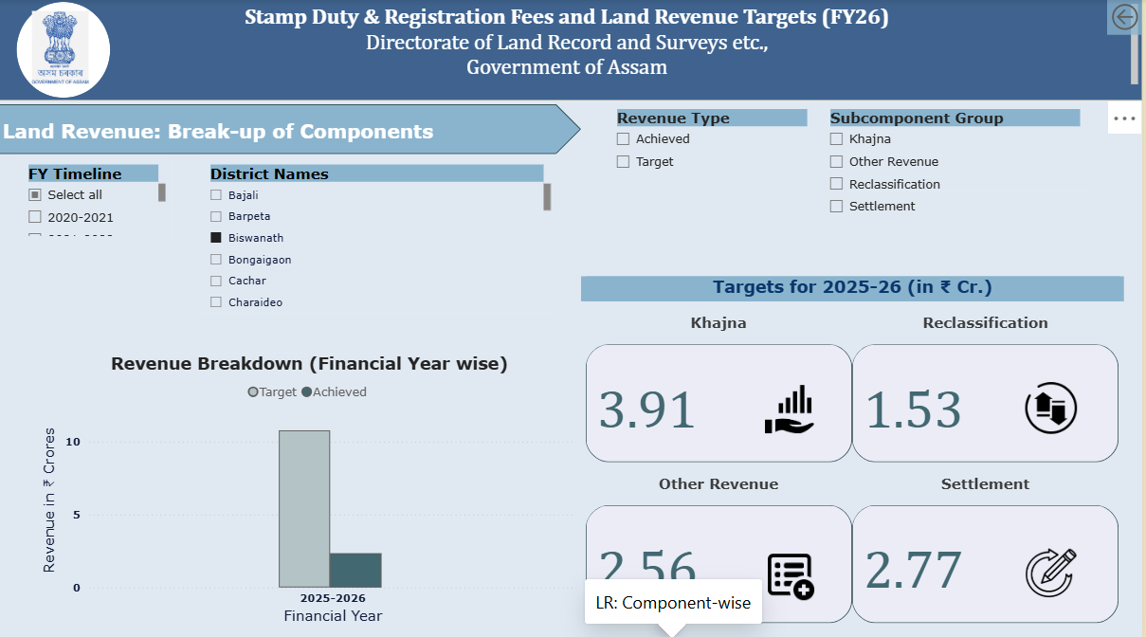
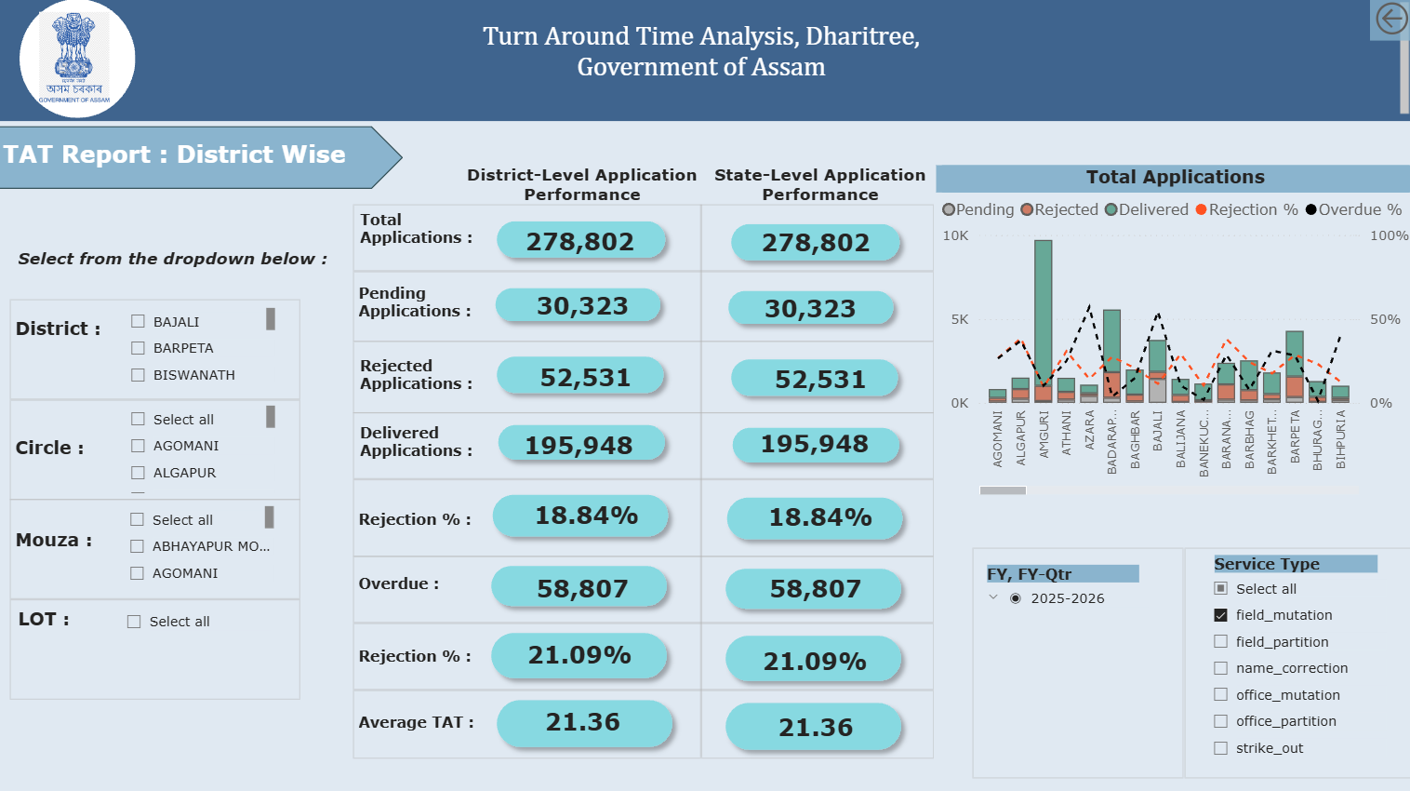
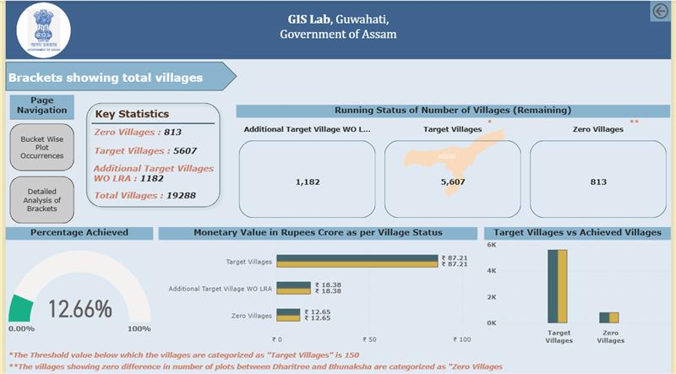
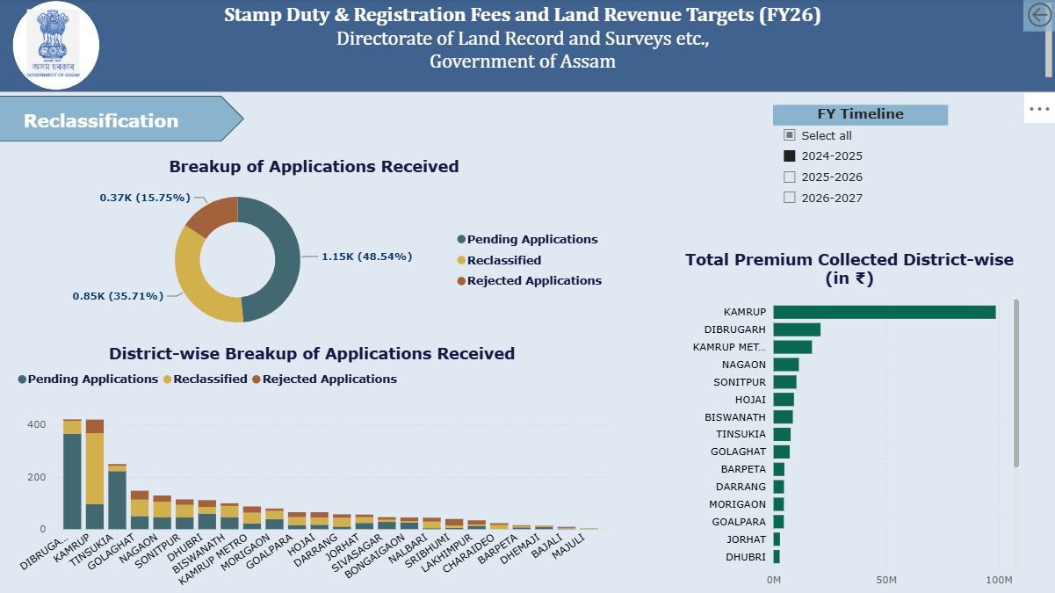
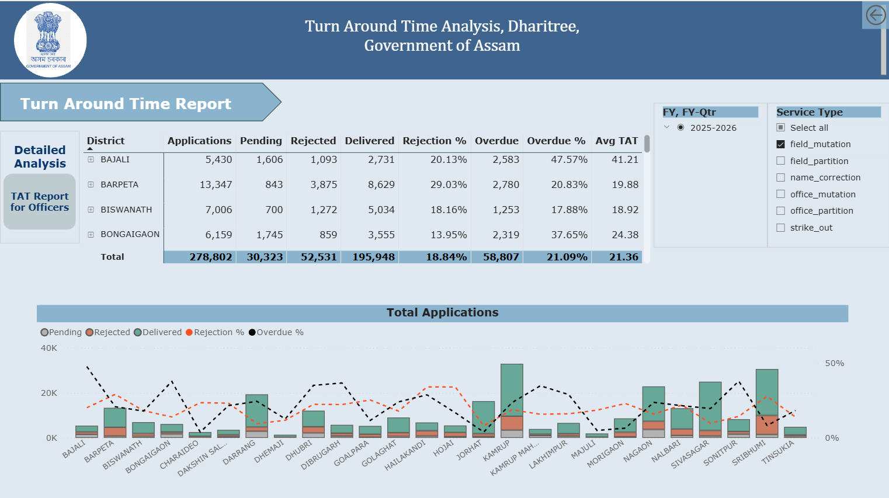
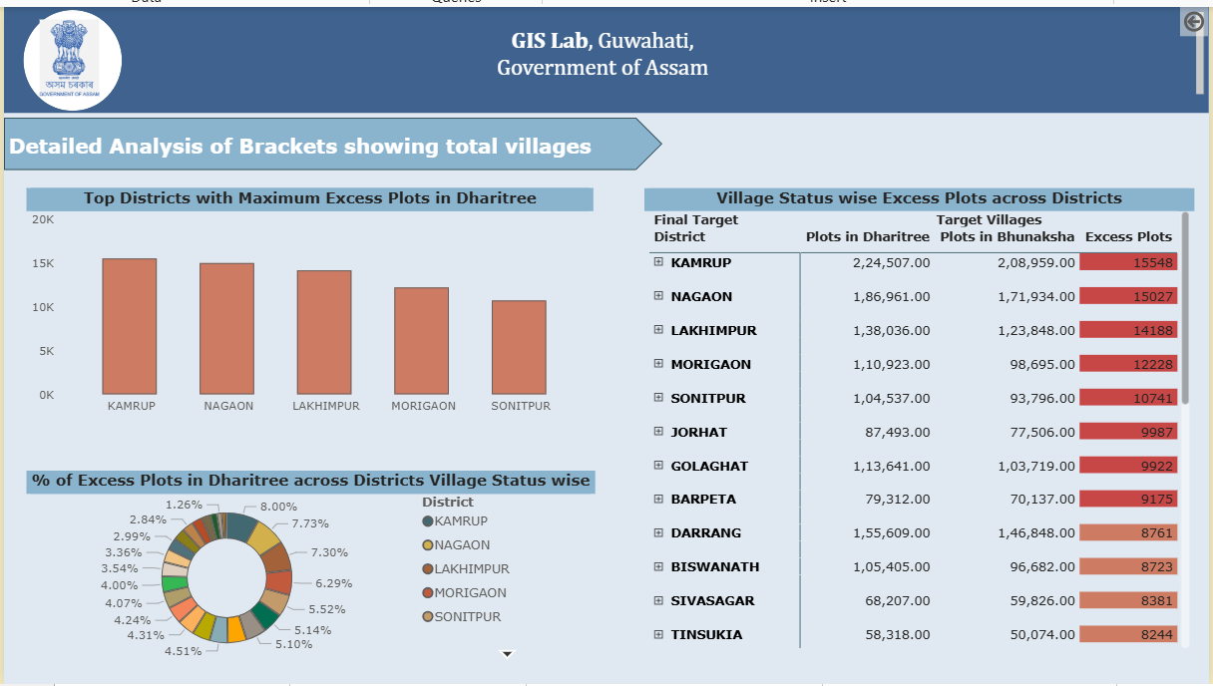
Illustrative Dashboard Snapshots
Revenue Monitoring Dashboard
TAT Monitoring
SASCI Monitoring

Slide 38
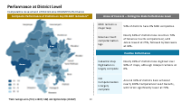
Deloitte’s Point of View: Support National Priorities under DILRMP
Lead India's shift toward a clean, conclusive, digitally-linked land record ecosystem
Leader in National Initiatives
Achieving the goals of DILRMP will position Rajasthan as a leader in advancing the national priorities of DILRMP
Enhanced Fund Availability
Executing DILRMP activities reduces State’s fiscal burden, as DOLR funds the activities aligned with RJ’s own priorities
Key Indicators for DILRMP 2026-27 to 2030-31
National Outlay ₹ Cr.
Rank 18
80
District-level performance of indicators
Rank 11
Rank 18
80
Identification of key challenges and bottlenecks, supported by SOPs and disaggregated dashboard-based monitoring, to maximise target achievement and ensure timely receipt of funds
Rank 18
80
Rank 7
15
70

Slide 39
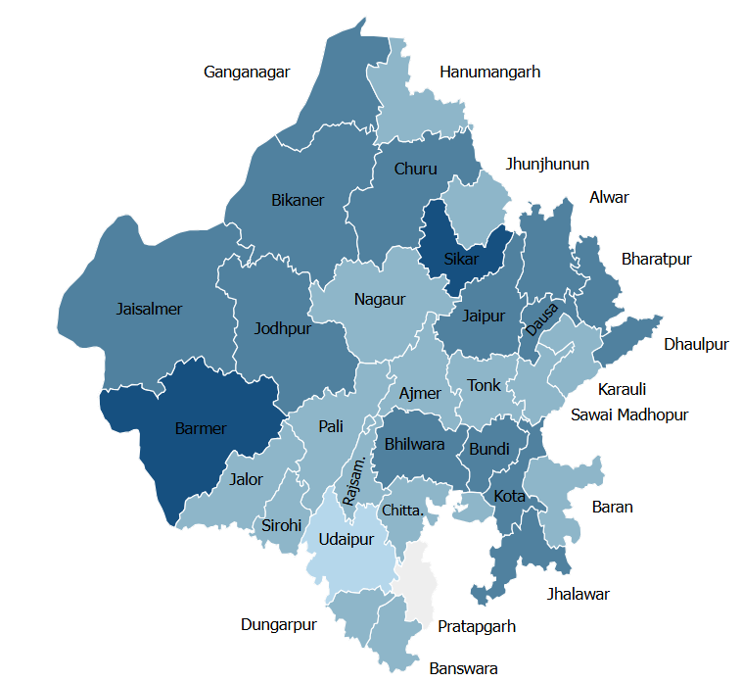
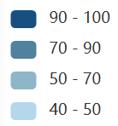
Performance at District Level
Comparative Assessment of District-level DILRMP Performance
Composite Performance of Districts on Key DILRMP Indicators*
Areas of Concern – Pulling the State Performance down
MRR remains a major Gap | 54% of districts have 0% MRR completion.
Revenue Court computerisation lags | Nearly 60% of districts have less than 70% of Revenue Courts computerised, with Jalore lowest at 25%, followed by Banswara at 33%.
Cadastral map Digitisation is largely complete | Nearly 90% of districts have digitised over 90% of maps, although Udaipur remains at 0%.
CLR Computerisation is largely complete | Around 90% of districts have achieved nearly 100% Computerized Land Records, with Sirohi significantly lower at 70%.
Sikar
Positive Performance
Barmer
*Note: Average score of CLR, E-RCMS, MRR, and Digitized Maps (DILRMP)

Slide 40
Deloitte’s Point of View: Align with Viksit Bharat & Viksit Rajasthan
Clear, investment-ready land for industrialisation and urban growth
Potential challenge:
Fragmented and outdated land records, complex processes and limited data integration can constrain land’s productive use, delay investment and development and limit Rajasthan’s ability to achieve its Viksit Rajasthan and Viksit Bharat priorities
Land Governance Reform
Contribution to the Viksit Agenda
Resurvey & modernise cadastral maps; accurate RoR; unique land IDs
Unlocks land for productive use, reduces disputes and supports faster development
1
Re-engineer processes; streamline services; rationalise jurisdictions
Reduces time and transaction costs, improving Ease of Living and Ease of Doing Business
2
Faster registration & mutation; simplified conversion; faceless services
Accelerates investment, urbanisation and infrastructure development
3
Focused land governance reforms, guided by a clear medium-term vision and strong implementation focus, can significantly advance the State’s and the country’s Viksit agenda
Integrate land & maps; AI; interoperable data; cybersecurity
Enables data-driven governance, better planning and efficient public service delivery
4
Build institutional capacity; Centre of Excellence; training; land literacy
Creates sustainable institutional capability and promotes inclusive, equitable growth
5

Slide 41
Deloitte’s Point of View: Improve Service Delivery for Citizens and Businesses
Simplified processes and consolidated legislation
Potential challenges in service delivery can be due to several systemic and process gaps
Process Gaps
Integration Limitations
Technology Gaps
1
Lengthy forms, difficult to understand by citizens – need for intermediaries
1
Need for citizens to upload multiple documents already available with govt.
1
Dated technology, fragmented database, monolithic architecture
2
Limited access to information – increased footfall at field offices
2
Limited information on encumbrances, litigation, mortgage etc. on land
2
Limited use of open source tech, emerging technology etc.
3
Digitized workflows with select manual steps – e.g., physical signatures
3
Manual data exchange on land acquisition details
3
Internet connectivity issues leading to manual processing of applications
4
Need for multiple visits to the field offices for single applications
4
Limited/manual data exchange for master plan development
4
Duplication of business logic, lack of centralised workflows
5
Inadequate timely response for grievance redressal
5
Point-to-point integration of own modules
6
Lack of structured forms, feedback etc. for process improvements/challenges
Business process re-engineering and integrated governance systems can simplify processes, reduce turnaround time, enhance transparency, and improve service delivery for citizens and businesses

